Slide 1
Threads

Slide 2
Objectives
To introduce the notion of a thread — a fundamental unit of CPU utilization that forms the basis of multithreaded computer systems
To discuss the APIs for the Pthreads, Win32, and Java thread libraries
To examine issues related to multithreaded programming

Slide 3
Motivation
Threads run within application
Multiple tasks with the application can be implemented by separate threads
Update display
Fetch data
Spell checking
Answer a network request
Process creation is heavy-weight while thread creation is light-weight
Can simplify code, increase efficiency
Kernels are generally multithreaded

Slide 4
A thread is a flow of execution through the process code, with its own program counter that keeps track of which instruction to execute next, system registers which hold its current working variables, and a stack which contains the execution history.
A thread shares with its peer threads few information like code segment, data segment and open files. When one thread alters a code segment memory item, all other threads see that.
A thread is also called a lightweight process. Threads provide a way to improve application performance through parallelism. Threads represent a software approach to improving performance of operating system by reducing the overhead thread is equivalent to a classical process.

Slide 5
Each thread belongs to exactly one process and no thread can exist outside a process.
Each thread represents a separate flow of control. Threads have been successfully used in implementing network servers and web server.
They also provide a suitable foundation for parallel execution of applications on shared memory multiprocessors. The following figure shows the working of a single-threaded and a multithreaded process.

Slide 6
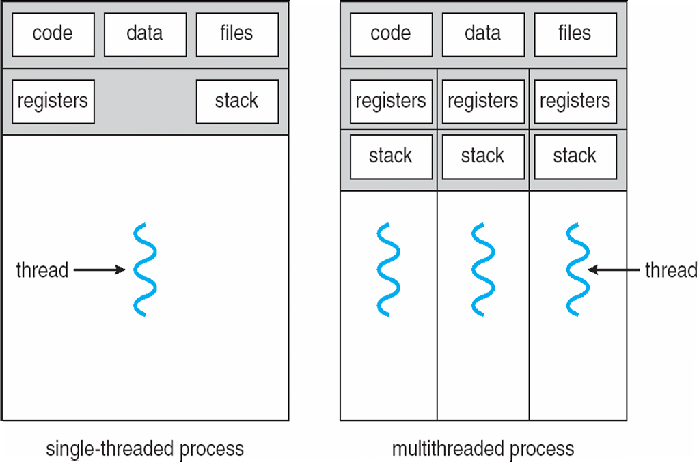
Single and Multithreaded Processes

Slide 7
Benefits
Responsiveness
Resource Sharing
Economy
Scalability

Slide 8
Multicore Programming
Multicore systems putting pressure on programmers, challenges include:
Dividing activities
Balance
Data splitting
Data dependency
Testing and debugging

Slide 9
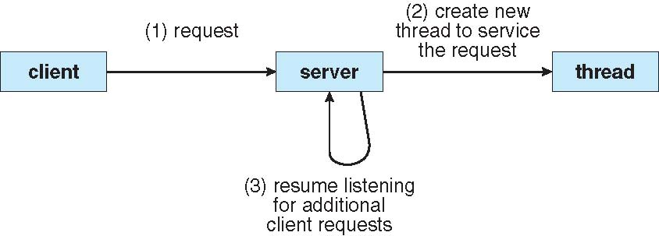
Multithreaded Server Architecture

Slide 10
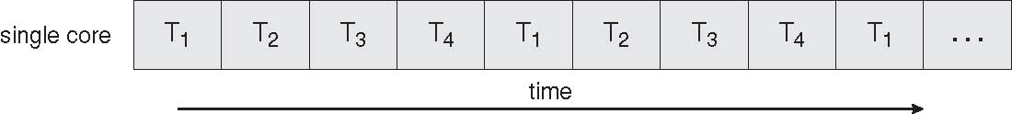
Concurrent Execution on a Single-core System

Slide 11
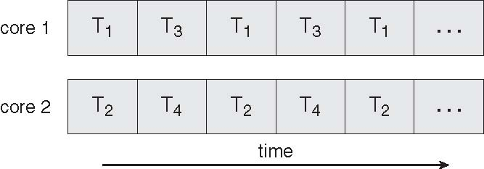
Parallel Execution on a Multicore System

Slide 12
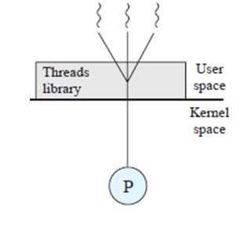
User Threads
Thread management done by user-level threads library
All of the thread management is done by the application and the kernel is not aware of the existence of threads.
Three primary thread libraries:
POSIX Pthreads
Win32 threads
Java threads
Advantages of user level threads:
There are a number of advantages to the use of ULTs instead of KLTs
Thread switching does not require kernel mode privileges
Scheduling can be application specific
ULTs can run on any OS.
Disadvantages of user level threads:
When a ULT executes a blocking system call, not only is that thread blocked, but also all of the threads within the process are blocked.
A Multithreaded application cannot take advantage of multiprocessing. A kernel assigns one process to only one processor at a time.

Slide 13
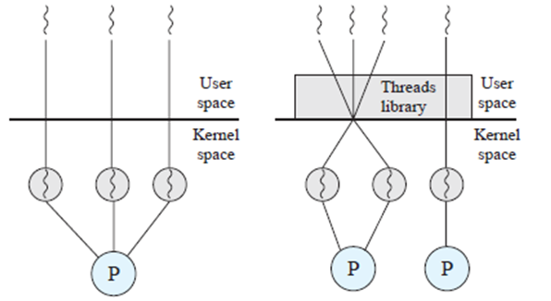
Kernel Threads
Supported by the Kernel
There is no thread management code in the
application level, simply an application programming
interface (API) to the kernel thread facility.
The kernel maintains context information
for the process as a whole and for individual threads
within the process.
Examples
Windows XP/2000
Solaris
Linux
Tru64 UNIX
Mac OS X
Advantages of Kernel level threads:
The kernel can simultaneously schedule multiple threads from the same process on multiple processors.
If one thread in a process is blocked, the kernel can schedule another thread of the same process.
Disadvantages of kernel level threads:
The transfer of control from one thread to another within the same process requires a mode switch to the kernel.

Slide 14
Multithreading Models
Many-to-One
One-to-One
Many-to-Many

Slide 15
Many-to-One
Many user-level threads mapped to single kernel thread
Examples:
Solaris Green Threads
GNU Portable Threads

Slide 16
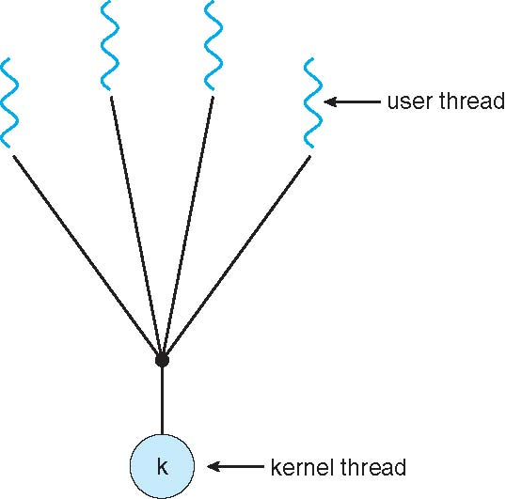
Many-to-One Model

Slide 17
One-to-One
Each user-level thread maps to kernel thread
Examples
Windows NT/XP/2000
Linux
Solaris 9 and later

Slide 18
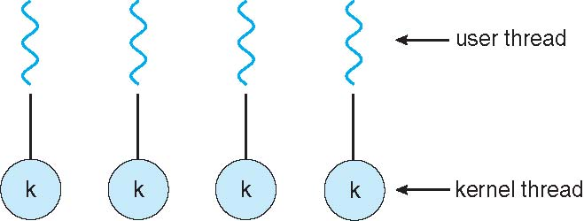
One-to-one Model

Slide 19
Many-to-Many Model
Allows many user level threads to be mapped to many kernel threads
Allows the operating system to create a sufficient number of kernel threads
Solaris prior to version 9
Windows NT/2000 with the ThreadFiber package

Slide 20
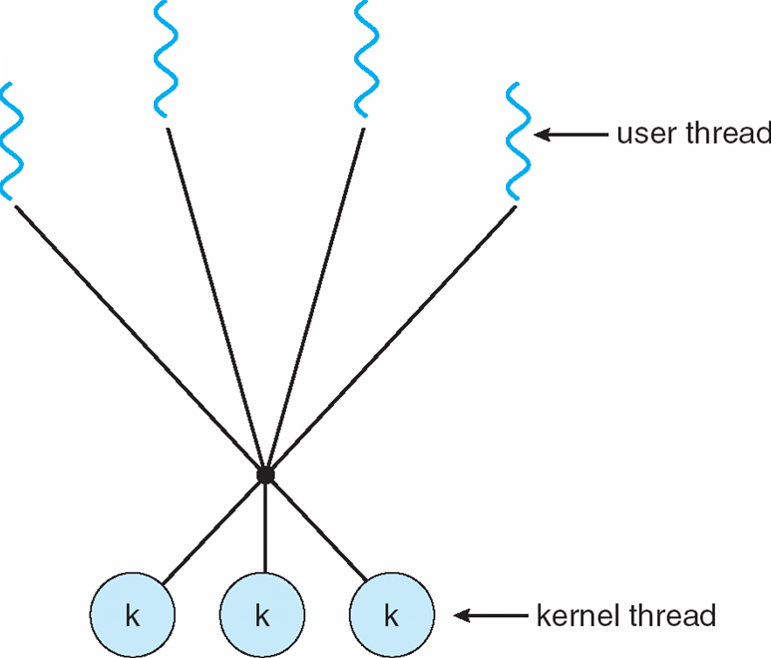
Many-to-Many Model

Slide 21
Two-level Model
Similar to M:M, except that it allows a user thread to be bound to kernel thread
Examples
IRIX
HP-UX
Tru64 UNIX
Solaris 8 and earlier

Slide 22
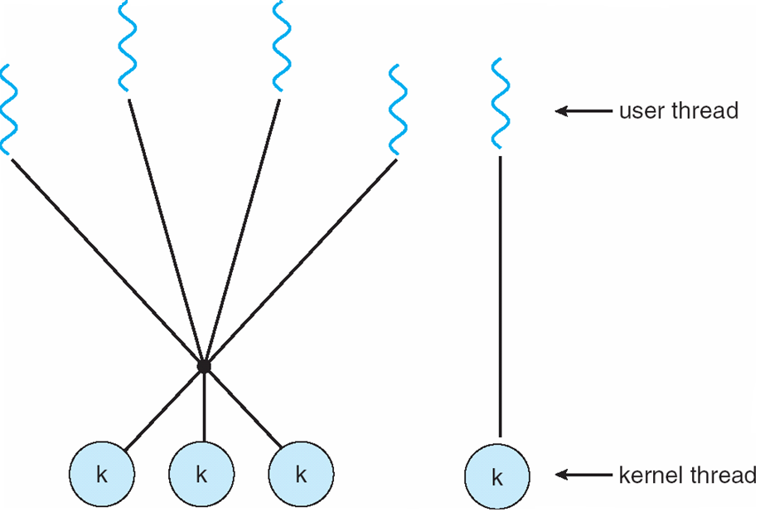
Two-level Model

Slide 23
Thread Libraries
Thread library provides programmer with API for creating and managing threads
Two primary ways of implementing
Library entirely in user space
Kernel-level library supported by the OS

Slide 24
Comparison Between Process and Threads
S.N. | Process | Thread
1 | Process is heavy weight or resource intensive. | Thread is light weight, taking lesser resources than a process.
2 | Process switching needs interaction with operating system. | Thread switching does not need to interact with operating system.
3 | In multiple processing environments, each process executes the same code but has its own memory and file resources. | All threads can share same set of open files, child processes.
4 | If one process is blocked, then no other process can execute until the first process is unblocked. | While one thread is blocked and waiting, a second thread in the same task can run.
5 | Multiple processes without using threads use more resources. | Multiple threaded processes use fewer resources.
6 | In multiple processes each process operates independently of the others. | One thread can read, write or change another thread's data.

Slide 25
Why Pthreads
The primary motivation for using Pthreads is to realize potential program performance gains.
When compared to the cost of creating and managing a process, a thread can be created with much less operating system overhead. Managing threads requires fewer system resources than managing processes.
All threads within a process share the same address space. Inter-thread communication is more efficient and in many cases, easier to use than inter-process communication.
Threaded applications offer potential performance gains and practical advantages over non-threaded applications in several other ways:
Overlapping CPU work with I/O: For example, a program may have sections where it is performing a long I/O operation. While one thread is waiting for an I/O system call to complete, other threads can perform CPU intensive work.
Priority/real-time scheduling: tasks that are more important can be scheduled to supersede or interrupt lower priority tasks.
Multi-threaded applications will work on a uni-processor system; yet naturally take advantage of a multiprocessor system, without recompiling.

Slide 26
Java Threads
Java threads are managed by the JVM
Typically implemented using the threads model provided by underlying OS
Java threads may be created by:
Extending Thread class
Implementing the Runnable interface

Slide 27
Threading Issues
Semantics of fork() and exec() system calls
Thread cancellation of target thread
Asynchronous or deferred
Signal handling
Synchronous and asynchronous

Slide 28
Threading Issues (Cont.)
Thread pools
Thread-specific data
Create Facility needed for data private to thread
Scheduler activations

Slide 29
Semantics of fork() and exec()
Does fork() duplicate only the calling thread or all threads?

Slide 30
Thread Cancellation
Terminating a thread before it has finished
Two general approaches:
Asynchronous cancellation terminates the target thread immediately.
Deferred cancellation allows the target thread to periodically check if it should be cancelled.

Slide 31
Signal Handling
Signals are used in UNIX systems to notify a process that a particular event has occurred.
A signal handler is used to process signals
Signal is generated by particular event
Signal is delivered to a process
Signal is handled
Options:
Deliver the signal to the thread to which the signal applies
Deliver the signal to every thread in the process
Deliver the signal to certain threads in the process
Assign a specific thread to receive all signals for the process

Slide 32
Thread Pools
Create a number of threads in a pool where they await work
Advantages:
Usually slightly faster to service a request with an existing thread than create a new thread
Allows the number of threads in the application(s) to be bound to the size of the pool

Slide 33
Thread Specific Data
Allows each thread to have its own copy of data
Useful when you do not have control over the thread creation process (i.e., when using a thread pool)

Slide 34
Scheduler Activations
Both M:M and Two-level models require communication to maintain the appropriate number of kernel threads allocated to the application
Scheduler activations provide upcalls - a communication mechanism from the kernel to the thread library
This communication allows an application to maintain the correct number kernel threads

Slide 35
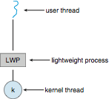
Lightweight Processes

Slide 36
Operating System Examples
Windows XP Threads
Linux Thread
Notes:
36

Slide 37
Linux Threads
Linux refers to them as tasks rather than threads
Thread creation is done through clone() system call
clone() allows a child task to share the address space of the parent task (process)
struct task_struct points to process data structures (shared or unique)

Slide 38
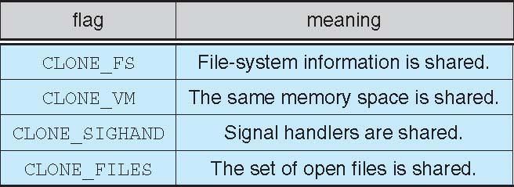
Linux Threads
fork() and clone() system calls
Doesn’t distinguish between process and thread
Uses term task rather than thread
clone() takes options to determine sharing on process create
struct task_struct points to process data structures (shared or unique)

